Slide 1
Text Mining and Sentiment Analysis Using Twitter Streaming API and Python
Social Media Mining

Slide 2
Agenda
Abstract
Methodology
Popularity analysis
Sentimental Analysis
Location Based Analysis
Location based sentiment analysis
Project Importance

Slide 3
Abstract
Twitter data constitutes a rich source that can be used for capturing information about any topic imaginable. This data can be used in different use cases such as finding trends related to a specific keyword, measuring brand sentiment, and gathering feedback about new products and services. Tweet content can be analyzed to understand conversation topics, characteristics of individuals or organizations tweeting, and public beliefs and opinions about a specific topic.
Twitter’s API provides a straightforward way to query for users and returns results in a JSON format which makes it easy to parse in a Python script. In this project, I am using Twitter data to compare the popularity of world leaders: Trump, Obama, Putin and Modi, and after getting this insight the next step is to get sentiment scores from the tweets through sentiment analysis.
In the final part of the project I have done location based filtering of the tweets and calculated the location based sentiments of the tweets for Trump in California ,Texas & Florida ,and comparing the results with 2016 presidential election.
Notes:
Marketing Analysis Project
Analyze popularity of President Trump in different States of project
Compared the popularity of world leaders : Trump, Obama, Putin and Modi
Used Twitter data and analyzed it using Python Script
Identified trends related to specific keyword, measured brand sentiment and understood public beliefs.

Slide 4
Methodology Followed
The project has various steps as follows:
Getting Twitter API keys
Connecting to Twitter Streaming API and downloading 10000 tweets.
Mining the tweets and calculating the popularity using bar charts.
Estimating overall sentiment of tweets through sentiment analysis and displaying it through
bar chart.
Location based filtering of tweets and getting area based counts and sentiments.
Comparing the results with empirical data to check for interesting insights.

Slide 5
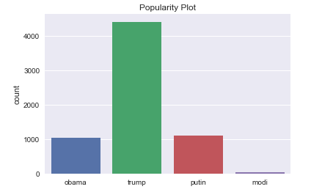
Popularity Analysis
Imported 1000 tweets from twitter.
Converted to a structured format into panda’s data frame.
Calculated the frequency of keyword in each tweet using text mining.
Frequency indicates the popularity of the candidate.
Trump is most popular among these world leaders.
Notes:
Imported 1000 tweets from twitter.
Converted to a structured format into panda’s data frame.
Calculated the frequency of keyword in each tweet using text mining.
Frequency indicates the popularity of the candidate.
Trump is most popular among these leaders in the world.
Total 10000 tweets are downloaded in a .txt file and then converted to a structured format into panda’s data frame. Thereafter, we calculated number of times a keyword appears in each tweet through text mining. Once we get the count ,we can say that the one having highest count is trending or he is most popular then the rest.

Slide 6
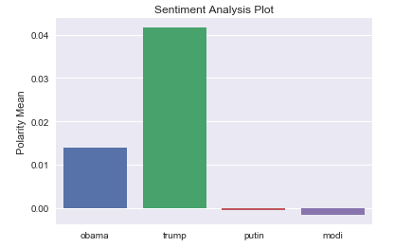
Sentiment analysis
Identified positivity and negativity tweets using sentiment analysis.
Polarity score is assigned to each tweet from -1 to 1
Polarity score > 0.1 -→ Positive tweet
Polarity score < 0.1 → Negative tweet
Calculated mean polarity of each leader to have an overall insights.
Notes:
Identified positive and negative tweets using sentiment analysis.
Polarity score is assigned to each tweet from -1 to 1
Polarity score > 0.1 -→ Positive tweet
Polarity score < 0.1 → Negative tweet
Calculated mean polarity of each leader.
We have an idea about who is trending among these leaders, but we don’t know whether they are trending for a good reason or for bad reason. To find the sentiments of the tweets and to get insight from them we perform sentiment analysis. In sentiment analysis a number is assigned to each tweet from -1 to 1. Generally, for a polarity score greater than 0.1 is considered positive tweet, for score in between 0.1 to -0.1 is considered neutral tweet and for -0.1 to -1 we call it negative tweet. Thereafter, calculated mean polarities for each leader, hence calculated overall polarity or sentiment.

Slide 7
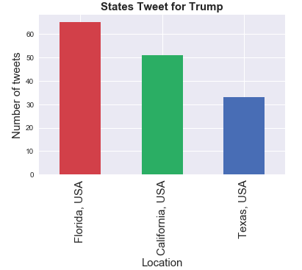
Location Based Analysis
Geo targeted analysis
Used to find insights for a particular area.
Tweets are filtered for different locations in US.
Top 3 states are chosen : Texas (Republican), California(Democratic) and Florida (Swing State).
Florida has high frequency of tweets while Texas has lowest.
Notes:
Targeted Analysis
Used to find insights for a particular area.
Tweets are filtered for different locations in US.
Top 3 states are chosen : Republican, Democratic and Swing State.
Florida has high frequency of tweets while Texas has lowest.
Location based analysis is used to find insights for a particular area .These insights are very helpful for targeted analysis .For people who tweeted for Trump the tweets are filtered for locations in united states and top 3 states are chosen for analysis.

Slide 8
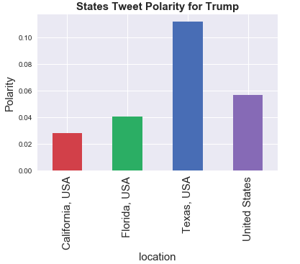
Location Based Sentiment Analysis
Location based sentiment for three states using Polarity analysis.
Compared with the whole US.
Texas has highest State tweet polarity.
California has lowest State tweet polarity.
Notes:
Location based sentiment for three states using Polarity analysis.
Compared with the whole US.
Texas has highest State tweet polarity.
California has lowest State tweet polarity.
Once we have the desired location based data we can now try to find the location based sentiment of the people of united states for the 3 states and compare it with whole united states

Slide 9
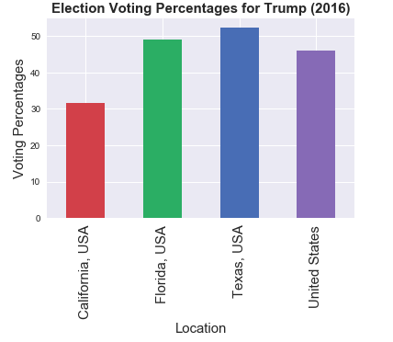
Comparing Results With Empirical Data

Slide 10
Project Importance
Improving the effectiveness of marketing campaigns with better targeting.
Understanding shopping patterns to improve customer experience.
Analyzing real-time traffic data to find quick business insights through dashboards.
Twitter represents an important data source for the disease prevention and control
community. Investigators in various research uses Twitter analysis.
Detection and prevention of epidemic or any emergency situation in any part of world .

Slide 11
Questions ?
Thankyou!!

